Slide 1

Towards Automatic Creation of Annotations to Foster Development of Named Entity Recognizers
Emanuel Matos,
Mário Rodrigues,
Pedro Miguel,
António Teixeira
IEETA, DETI, Universidade de Aveiro, Portugal

Slide 2
Outline
Named Entity Recognition - NER
Motivation
Main Objectives
Our proposal
a system to create the annotated data automatically, by resorting to a set of existing NERs and information sources (DBpedia)
First Results
Future Work

Slide 3
NER
Named entities are single-word or multi-word expressions that refer to specific individuals, such as people and organizations, or denote other concrete information such as postal and e-mail addresses or dates.
They are expressed using specific patterns (ex: addresses, dates, e-mails) or composed by a sequence of nouns referring a single entity
Examples: “António Guterres” or “The Secretary-General of the United Nations” which, in 2021, refer to the same person.
Automatic recognition of these named entities is the objective of Named Entity Recognition (NER)
a key step used in several natural language processing (NLP) tasks

Slide 4
Motivation / Problem(s)
The performance of out-of-the-box NER systems is not always adequate for specific domains
preventing its wider adoption
Most systems provide methods to train and adapt them to concrete applications
this adaptation is usually limited to developers with in-depth knowledge of the area and/or having access to large amounts of annotated texts

Slide 5
Motivation / Problem(s)
Obtain or create annotated data that associates words or sequences of words to a type of entity is essential
In general a major problem
Challenge is to train existing systems using these data
Expressing data in the format accepted by existing systems
also doing so in a way non-developers feel comfortable with
Not easy to have data to train ML approaches for new domains
…

Slide 6
Motivation / Problem(s)
Personal
Understand more about OIE
Apply OIE into Recommendations
Help or Facilitate People/Organisations in general to understand more about what is necessary.
Scientific
Keep up to date, as been as possible, the technics from OIE
Create a ML systems with minimum Human Operations
With flexibility and easybility for working with it.

Slide 7
Main Objectives
Develop processes to simplify the creation of NER systems for new domains
starting by the creation of the needed annotated data
Make as much as possible the development processes easy to use by non specialists
contributing to democratization of usage of such systems

Slide 8
Current Approaches to NER
The most relevant Types.
Some Technics based it.
"Today is only for keep in brain."
Main Type | Technics | Example
Rule based | Surface
 | Gazetteers
NER using ML | Supervised “classic” ML | HMM SVM CRF
 | Unsupervised
 | Reinforcement
 | Deep | RNN Transfer Learning Transformers

Slide 9
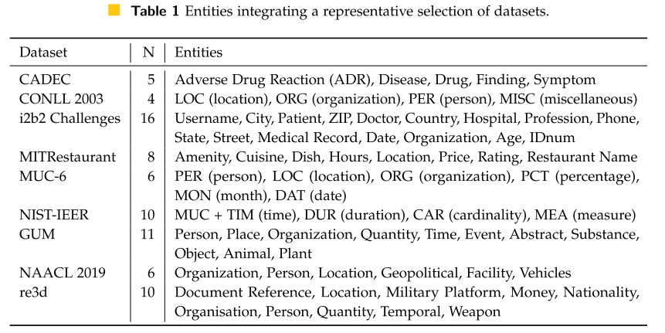
Examples of entities
Quite common: PERson, LOCation, ORGanization, MISC

Slide 10
NER systems for Portuguese
Several systems can detect and tag Named Entities in texts in Portuguese, being particularly relevant the following:
Systems
Linguakit | NLPyPort
AllenNLP | StanfordNLP
FreeLING

Slide 11
Recent developments for Portuguese
LeNER-Br system (2018)
developed for Brazilian legal documents
Based on LSTM-CRF models
F1 scores of 97.04% and 88.82% for Legislation and judicial entities
Pirovani and coworkers (2019)
hybrid technique combining Conditional Random Fields with a Local Grammar (CRF+LG)
adapted to various textual genres in Portuguese (IberLEF 2019 task)

Slide 12
Recent developments for Portuguese
Lopes and coworkers (2019)
NER for Clinical data in Portuguese with BiLSTMs and word embeddings
F1-scores slightly higher than 80% and equivalent results for both Precision and Recall. Pre-processed by NLPPort and processed by BiLSTM-CRF and CRF for comparison. BiLSTM was superior in all comparisons for "In-Domain" models
Mariana Dias and coworkers (2020)
NER was applied to sensitive data Discovery in Portuguese
Unstructured text information in European Portuguese combining several techniques(Lexical rules, machine learning algorithms and neural networks)
rule-based approaches were used for a set of specific classes (ex: NumIdentificacaoCivil). For the other classes of entities, CRF, Random Fields and BiLSTM were used

Slide 13
Proposed Solution
NER without annotated data using an Ensemble of NERs

Slide 14
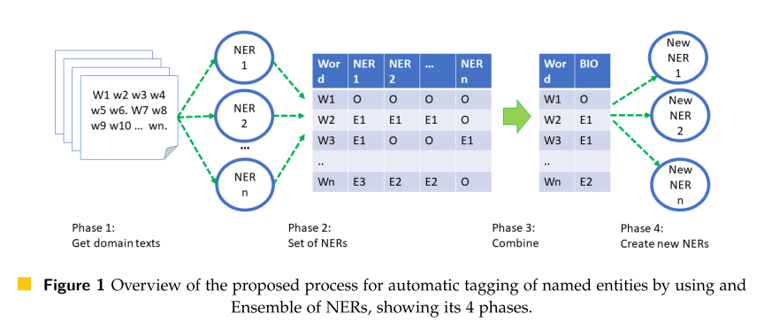
Overview
To provide annotated corpora for development of new NER systems we propose to explore the combined use of several existing NER systems and resources capable of providing information regarding entities and their types, for example DBpedia

Slide 15

The 4 phases – 1 & 2
Phase 1: Obtaining documents for the domain
A set of sources were selected manually, and the text scrapped using the Scrapy library for retrieving documents and BeautifulSoup library for getting document data.
One of the main sources selected was Wikivoyage.
Phase 2: Application of an Ensemble of NERs
From the NERs capable of processing texts in Portuguese, a subset was selected covering the main types.
Linguakit.
AllenNLP
NER based in DBpedia

Slide 16
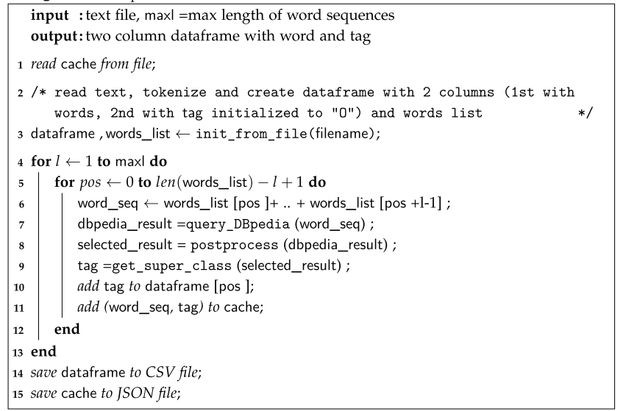
Dbpedia-based NER
For all sequences l words
Create word sequence
Query DBPedia
Selection of result by postprocessing
Search for super class by repeated queries
Store in cache

Slide 17
The 4 phases – 3 & 4
Phase 3: Combination of the outputs of the Ensemble of NERs
New tag candidates from the tags produced by the 3 NERs
Winner Take All (WTA)
assigns the most common tag
augmenting the confidence in the tags
Entity detection (ENTITY)
tags words as only Entity or not,
producing annotated data useful to train entity detectors (not including classification of the entity)
Phase 4: Exploration of the results
Analyzed in terms of agreement among NERs.
evaluated against manually annotated data.

Slide 18
Results

Slide 19
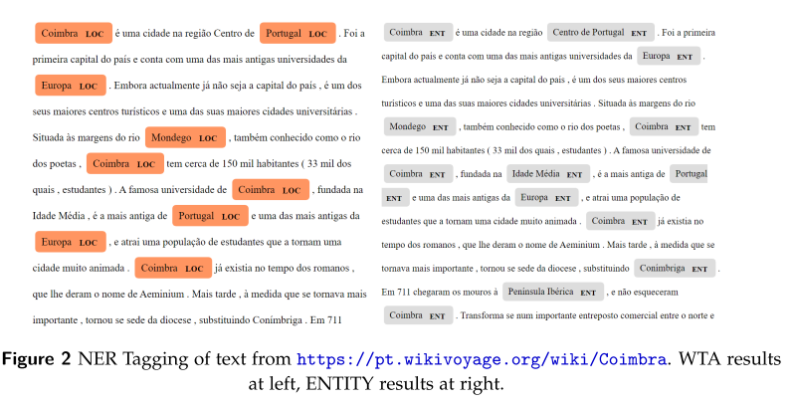
Examples

Slide 20
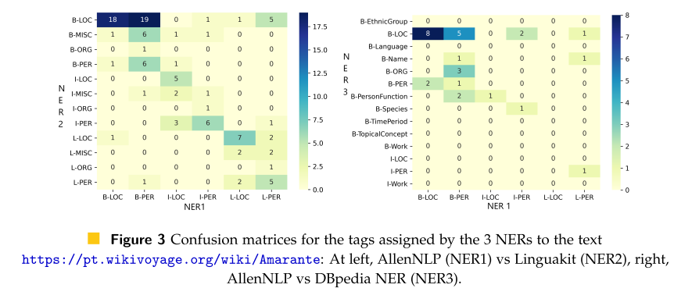
NERs output analysis
The analysis started by looking both confusion matrices and computing a simple similarity measure (Jaccard similarity calculated not considering the cases where "O" BIO tag was assigned by the NERs being compared).

Slide 21
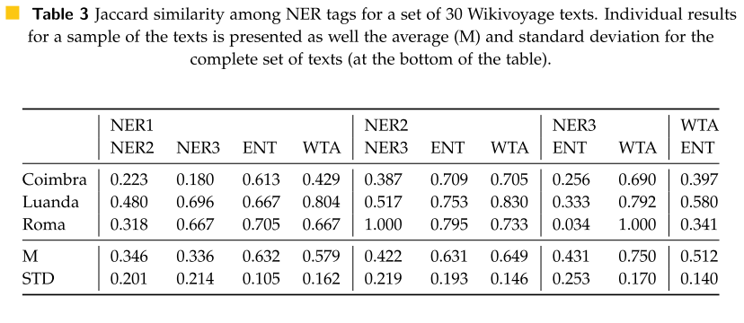
Similarity among NER tags
Systems produce quite dissimilar results, being the higher Jaccard similarity only 0.422 (for Linguakit versus DBPedia-based NERs);
Many of the entities marked as LOCATION by Linguakit and DBPedia are tagged as PERSON by AllenNLP
DBPedia NER detects a richer set of entities than the other two
WTA tags are more similar to the DBPedia-based NER

Slide 22
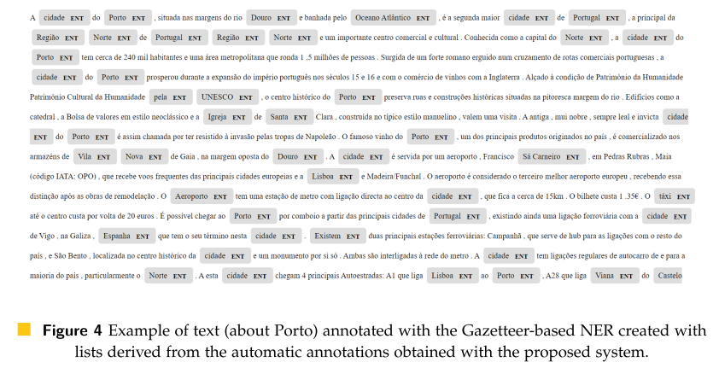
New NERs
In this example, we show Entities annotated based only the list of entities obtained by applying the previous phases.
The Figure shows that the Gazetteer-based NER could recognize several named entities
A major problem is clear, the approach is not capable of handling continuous or close parts of an entity (ex: “cidade do Porto”) and fails to recognize several entities (ex: “Vigo”)
Example of Results:

Slide 23
(ongoing) Training of neural NERs
Use of tagged data to train NERs:
systems based on BERT for instance, both for ENTITY/NO-ENTITY tagging and to classify with tags adequate to the domain.

Slide 24
Conclusion
The problem of automatic annotation of Named Entities is addressed in this paper, being proposed the combined used of an ensemble of NER systems
A first proof-of-concept of the proposed method was implemented with 2 existing NER systems and a DBpedia-based NER developed by the authors
The initial results revealed that combining the outputs of the NERs ensemble has potential to both extend the set of entities and contribute to reduce the difficulties distinguishing some entities
With the combination strategy providing a 1-class annotation, the proposed system could detect an interesting set of Named Entities in texts related to Tourism
that were used to create initial versions of new Gazetteer-based NERs

Slide 25
Future work
Improve the NERs integrating the Ensemble
Addition of new NERs to the Ensemble
Test the system in new domains

Slide 26
Thanks for your attention. Any questions?

